Slide 1
CI/CD
Nationwide
Kadambari Athreya

Slide 2

MY Background
Kadambari Athreya
Cloud Success Team – Consulting
14 yrs in IT
Nationwide since 2012

Slide 3




CI – Continuous Integration
Most application project have multiple developers working in the same code-base
Commits to the repository will trigger the build and test process to ensure your changes still work with the rest of the app

Slide 4

CI – Continuous Deployment
Once the integration of the code is successful (Build & Test), the application can be deployed

Slide 5

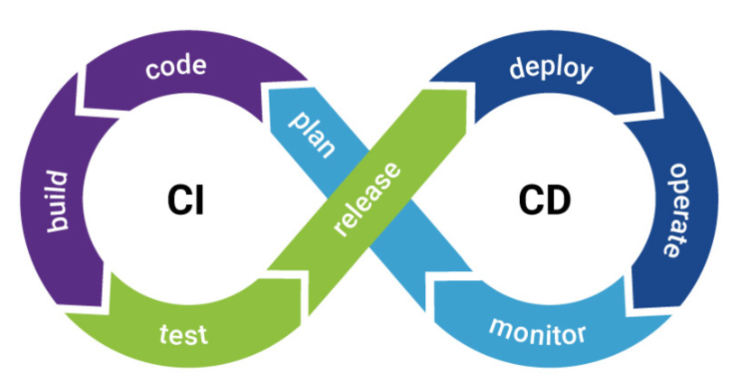


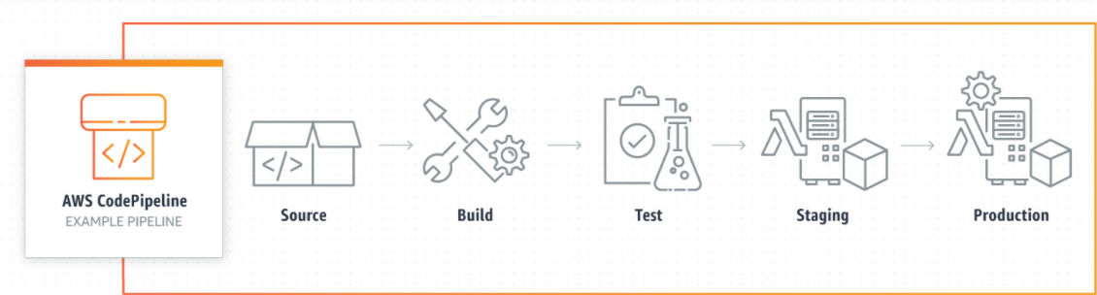
How – The Tools
CI/CD Pipeline
Jenkins

Slide 6
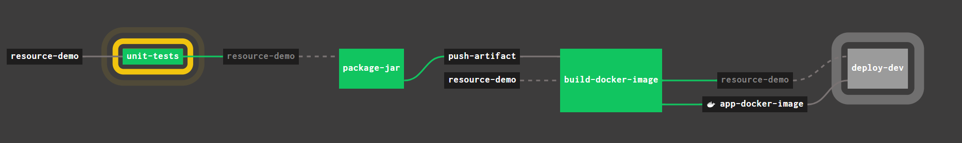
ExamplE - Concourse
Image creation
Deploy to a Kubernetes environment
Package the Application
Code Repo

Slide 7
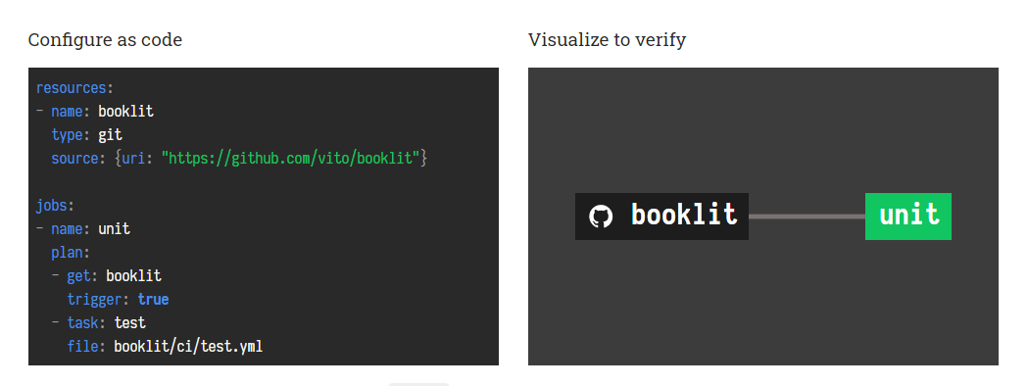
ExamplE - CONCOURSE
Site: https://concourse-ci.org/
Tutorial: https://concoursetutorial.com/

Slide 8
QUESTIONS ?

